Slide 1

User Experience Design/Testing Instructor: Prof. Vishal Chawla
College of Engineering

Slide 2


Balsamiq
College of Engineering
Affordable, easy to use software with drag and drop graphical user interface.
Extensive collection of widgets to rapidly build wireframe.
Desktop runs on any platform supported by Adobe Air, including Windows, Mac, Linux.
Good for rapid prototyping and screen design.
Developed by Balsamiq Studios LLC

Slide 3

Key Features of Balsamiq
Low-Fi Sketch Wireframes
Click-Through Prototypes
UI Components & Icons
Export to PNG or PDF
Quick Add for Speed
Import and Export
Drag and Drop for Simplicity
Full Keyboard Support
Specifications
Intended Users: Large Enterprises, Mid Size Business, Small Business
Devices Supported: Linux, Mac, Windows, Web-based
Supported Countries: Australia, Canada, Europe, United Kingdom, United States
Supported Languages: English
Support Options: FAQs, Forum, Knowledge Base, Online Support, Phone Support, Video Tutorials

Slide 4
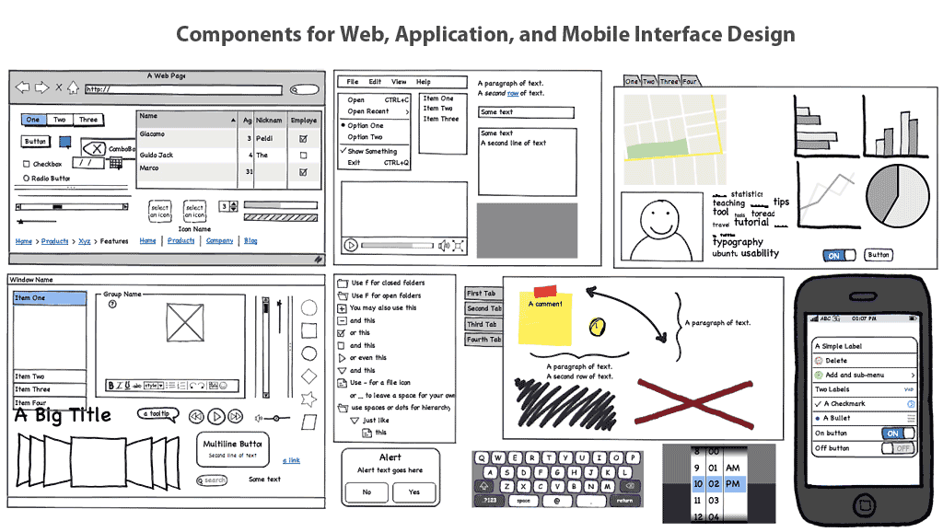
Balsamiq screenshot
College of Engineering

Slide 5
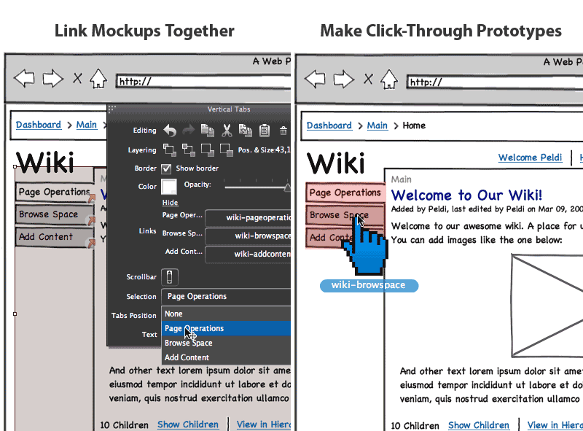
Balsamiq screenshot: Linking
College of Engineering

Slide 6
Moqups | Balsamiq
Moqups is fast and does not require any plugin. | Balsamiq required Flash player
User cannot navigate to linked pages by simply clicking on the links. | Link from each widget allows editing the widget.
Clean design and vey intuitive | Clean and easy to use interface
Offers upgrades for educational organizations. | Allows team collaboration using the following: Notifications Revision Control Skype Integration Access Control
Upload image and then drag and drop in the page | Cannot drag and drop an image directly

Slide 7
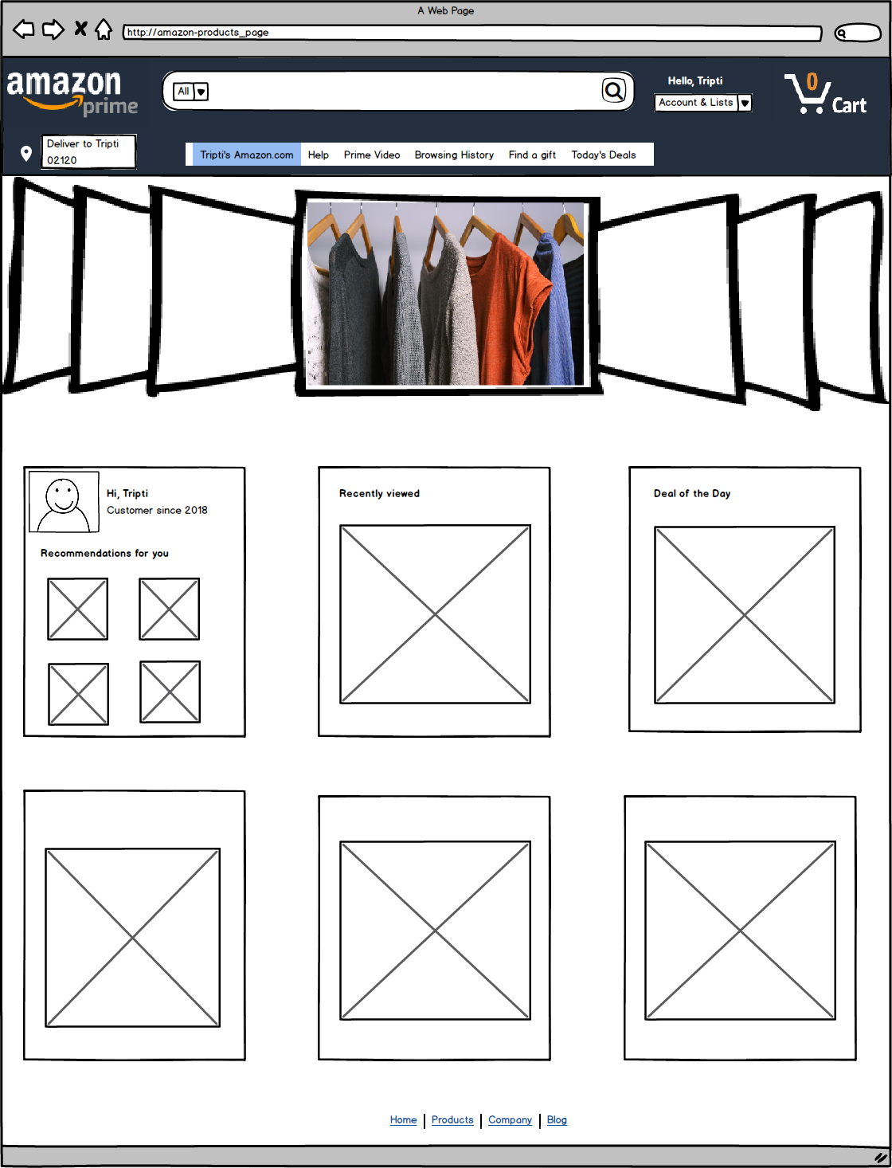
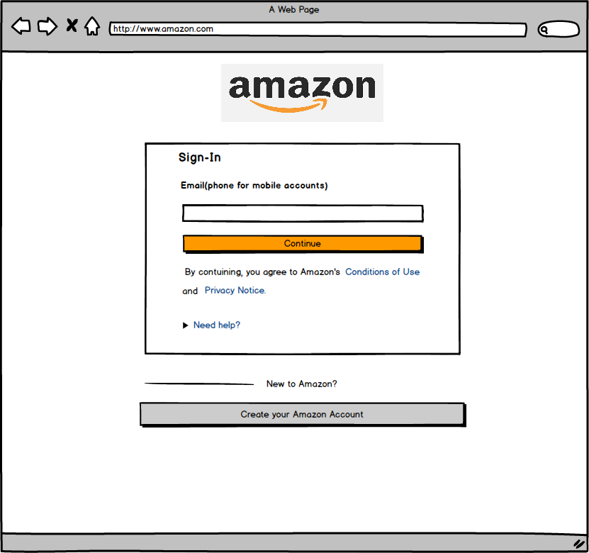
Balsamiq Lab

Slide 8
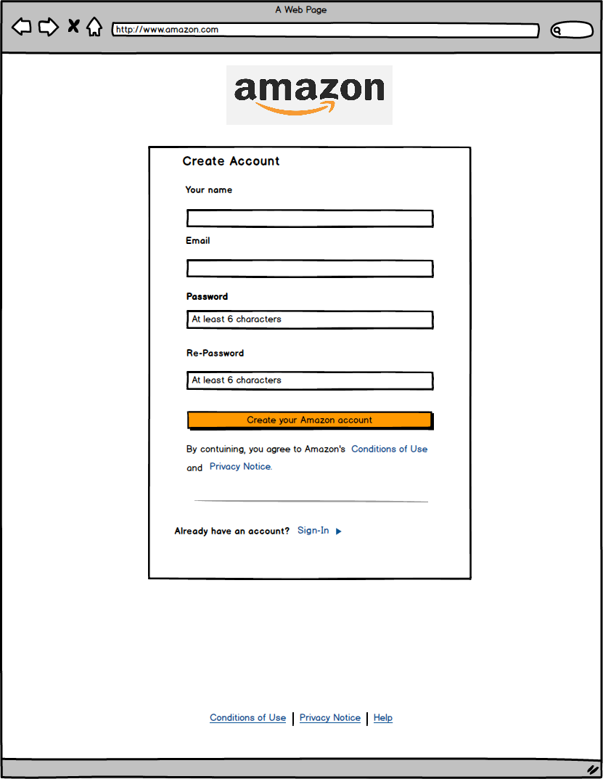

Slide 9
Assignment: 05
Design the wireframes for mobile apps for any one of these: Airbnb, Target, Walmart.
You can work in groups.
Be creative.
Minimum 5 complete pages required with interactions, proper colors and images.

